Slide 1







Percentages

Slide 2




Lesson Outcome
Understand the Concept of Percentage
Convert Between Fractions, Decimals, and Percentages
Solve Real-World Problems Involving Percentages

Slide 3








  Michael, Bill and Charles
  participated in a shooting game. The table shows their respective scores.
 | Shots Made | Attempts
Michael | 7 | 10
Bill | 13 | 20
Charles | 15 | 25
  Who’s the best shooter?

Slide 4


Who’s the most accurate shooter?
 | Shots Made | Attempts | Percentages
Michael | 7 | 10 | 70%
Bill | 13 | 20 | 65%
Charles | 15 | 25 | 60%
  COMPARING PERCENTAGES
  Michael is the best shooter, with the highest shot percentage out of all the attempts made!

Slide 5






Find the following
1)37.5% of 976 =
a.324 b.388
c.366 d.372
2)62.5% of 704 =
a.440 b.430
c.460 d.470
3)11 (1/9)% of 918
a.94 b.96
c.114 d.102

Slide 6





How do we express percentages into fractions?
  PERCEN﻿T MEANS OUT OF 100

Slide 7

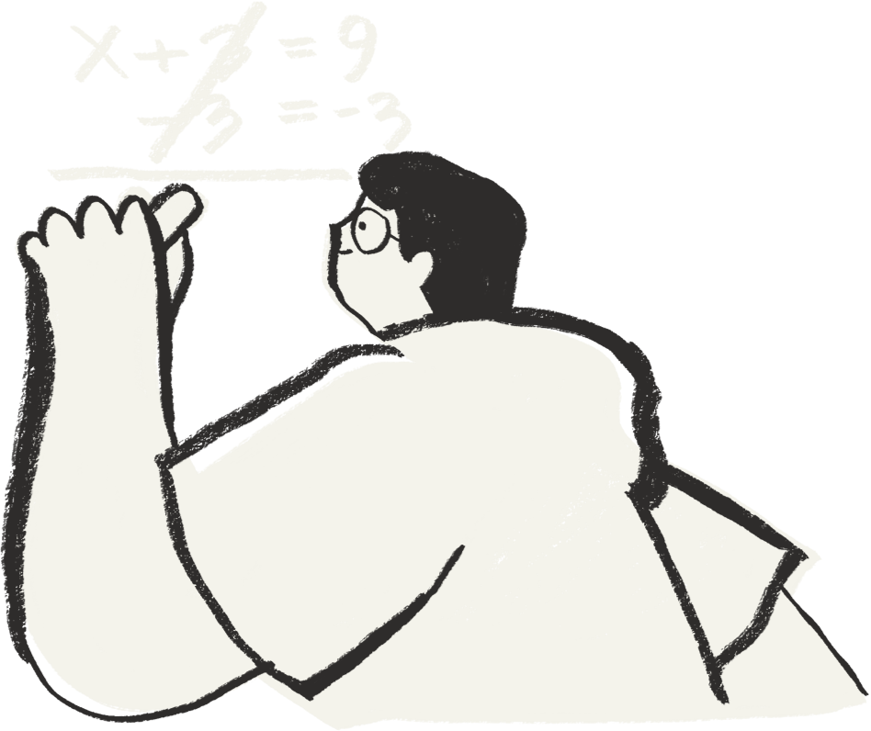

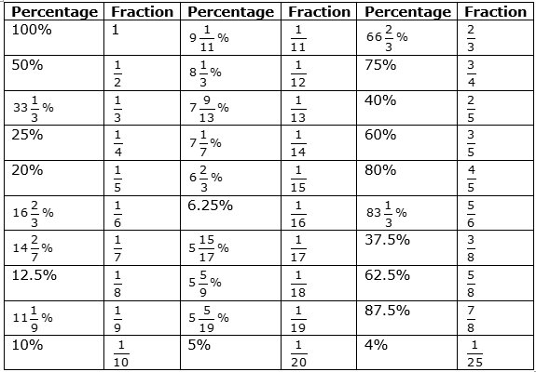
Percentages to Fractions

Slide 8
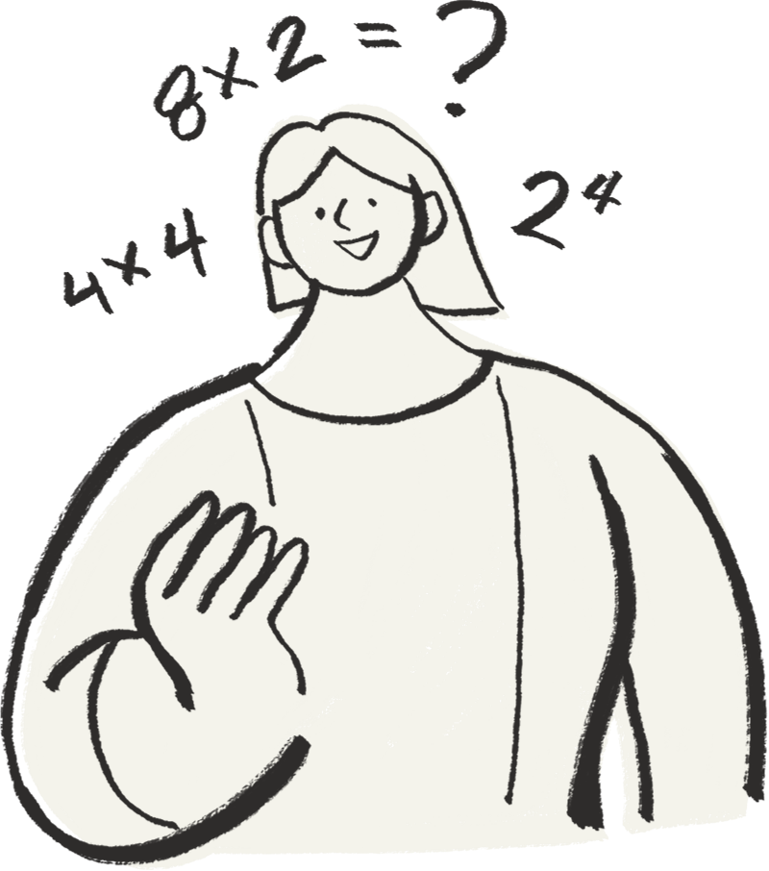
4)64 is what percent of 80?
a.80% b.70%
c.60% d.64%
5)3/20 is what percent of 12/25?
a.42.75% b.31.25%
c.35.5% d.40.5%
6)What percent of 125 is 16?
a.12.8% b.15%
c.20% d.25%

Slide 9


In an examination A got 80 marks and B got 60 marks, then 7)what percent of A’s mark is B’s mark?
a.80% b.75%
c.60% d.65%
8)By how much percentage A’s mark more than that of B?
a.35% b.33(1/3)%
c.25% d.44(4/9)%
9) By how much percentage B’s mark less than that of A?
a.35% b.33(1/3)%
c.25% d.44(4/9)%

Slide 10
Percentage Change
Change = [Change in Value / Base Value] × 100
(1) When the new amount is greater than the original amount, then it is a percent increase.
(2) When the original amount is greater than the new amount, then it is a percent decrease.

Slide 11
Exercise (i)
1)Aamir saves 32% of his monthly salary.If he spends Rs.27200, then find his savings?
a.15400 b.14300
c.13200 d.12800
2) Rama’s monthly income increased by 25%. Her new monthly income is ₹6,000. Find her initial monthly income.
a.2400 b.3200
c.4800 d.5600

Slide 12

3)If P gets 25% more than Q, then by what percent does Q get less than P?
a.33(1/3)% b.30%
c.16(2/3)% d.20%
4) Venkat’s salary was first increased by 20%, then it was decreased by 20%. If his latest salary is ₹7200, then what was the initial salary of Venkat?
a.7200 b.7500
c.6800 d.None of these

Slide 13


Successive Percentage Change
Suppose a number N undergoes a percentage increase of X% and then Y%, the net change will be
Increase = X+Y+(XY/100)
Suppose a number N undergoes a percentage increase of X% and then decrease of Y%, the net change will be
Change = X-Y-(XY/100)

Slide 14

Suppose a number N undergoes a percentage increase of X% and then a percentage decrease X%, the net change will be
Decrease = x²/100

Slide 15
5) Anurag gets 25% of the total marks in an examination and fails by 25 marks. Naveen gets 50% of the total marks and gets 20 marks more than the pass mark. Find the total marks.
a.200 b.180
c.300 d.150
6) In an election there are only three contestants P, Q and R. P secured 25% of the votes and Q secured 60% of the remaining votes. If R secured 9600 votes, by how many more votes has the winner won the election?
a.3200 b.4800
c.5200 d.None of these

Slide 16
7) Keerthana decided to donate 15% of her salary. On the day of donation she changed her decision and donated ₹3,600 which is 20% less than what she decided to donate. How much is Keerthana's salary?
a.₹45,000 b.₹30,000
c.₹28,000 d.₹25,000
8) In an office, totally there are 6400 employees and 65% of the total employees are males. 25% of the males in the office are at least 50 years old. Find the number of males aged below 50 years.
a.1040 b.2080
c.3120 d.4160

